Slide 1

DZ Bank Implementation Partner for TPH Upgrade Project
1st February 2026

Slide 2
NOTICE TO THE RECIPIENT OF THIS PROPOSAL - LEGAL DISCLAIMER
The information in this document is provided in strict confidence. This document contains business and trade secrets of Capgemini and/or third parties who have authorized Capgemini to use and disclose such information. It may only be used for the purpose of evaluating the information contemplated herein and be transmitted to professional advisors to this end. Without the prior consent of Capgemini, it must not be produced in whole or in part, given or communicated to any third party, whereas affiliates of the parties in the meaning of Section 15 et seq. of the German Stock Corporation Act (AktG) and their employees are not deemed to be third parties in this context.​
Any trademarks and other service marks contained in this document including the Capgemini name and logos, are the property of respective owners and may not be used without their prior written permission. ​
The offer is based on the information made available to Capgemini for the purpose of the offer, the documents and data provided, and the assumptions made and disclosed by Capgemini.​
Capgemini reserves the right to adjust the offer in consultation with you should it become apparent during the further course of the tender process that information, documents or assumptions are no longer applicable or are incomplete.
The offer for the services provided by Capgemini is submitted on the basis of the Master Agreement for work and services and supplementary agreements concluded between R+V Allgemeine Versicherung AG and Capgemini Deutschland GmbH on 31.05.2011.
The submission of this offer does not result in a binding contract between the parties. An effective agreement will only come into effect upon the conclusion of an individual contract binding on both parties (Project Agreement) under the abovementioned MSA. We are very confident to come to such individual contract with you.
The profiles of our team members provided are indicative. Depending on the availability at the actual time of the project Capgemini may provide alternative equivalent profiles. The curricula vitae of employees of our company attached to our proposal should give you an overview of the know-how and experience available within our company. Any determination of the actual project team shall be made in accordance with any qualifications identified together with you as necessary during the project preparation and under consideration of the employees as presented in our proposal.

Slide 3

1
MANAGEMENT SUMMARY
2
WHY CAPGEMINI?
3
OUR SCOPE OF SERVICES
4
OUR COMMERCIAL PROPOSITION
5
OUR INDICATIVE TEAM
6
APPENDIX

Slide 4
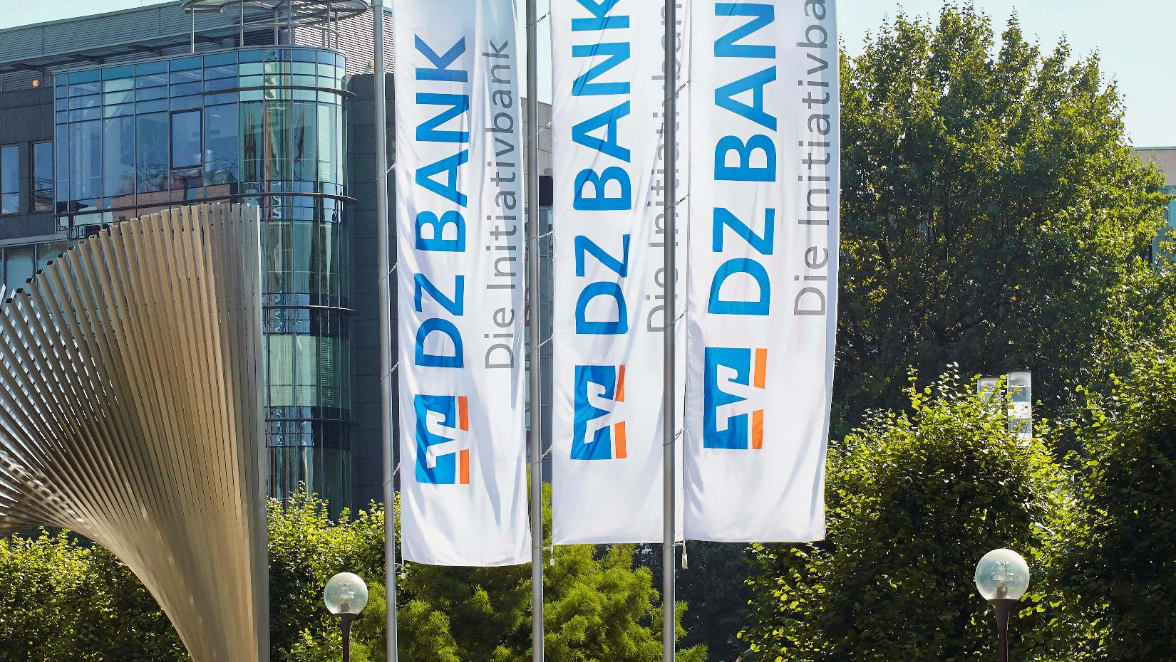
Management summary

Slide 5
MANAGEMENT SUMMARY
Success factors/risk potential Please describe the success factors that you consider to be of relevance. What are the greatest challenges, what solution approaches do you offer?
Brief financial presentation of the PROVIDER’s proposal

Slide 6
Why Capgemini?

Slide 7














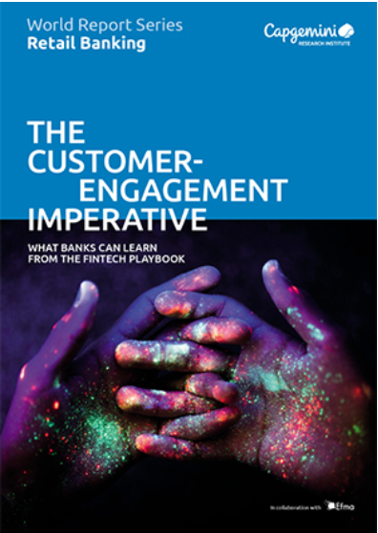





WE ARE A GLOBAL COMPANY FOCUSSING ON VALUE CREATION FOR OUR CLIENTS
Capgemini at-a-glance
Capgemini One Team
Business Sub Brands
Our Financial Situation from Past 5 years
Group Revenue for FY2024:
€ 22.09Bn
Present in nearly
50+ countries and 160+ nationalities
Partners
NET ZERO business by 2040
341,100+ talents worldwide working together as one team
See other sub-brands
Capgemini Financial Services Overview- World Leader
Financial Services Highlights
Focus Areas
Thought Leadership
FS sector contributing 22% revenue
70,000+ Team Members dedicated to the FS industry
Certified Delivery centers across the Globe
Domain Led Solutions/IP – Deep domain knowledge, unparalleled thought leadership and highest average years of consultant experience in financial services
Banking & Capital Markets
Retail, Corporate & Investments, Cards & Payments, Trade Lifecycle, Asset Management, Wealth Management, Custodian Operations, Brokerage Services
Insurance
Life & Annuities, Property & Casualty, Health, Re Insurance
2025 World Wealth Management Report
2025 World Retail Banking Report
2025 World Payments Report
12 of the top 20 diversified financials firms
9 of the top 10 investment banks

Slide 8




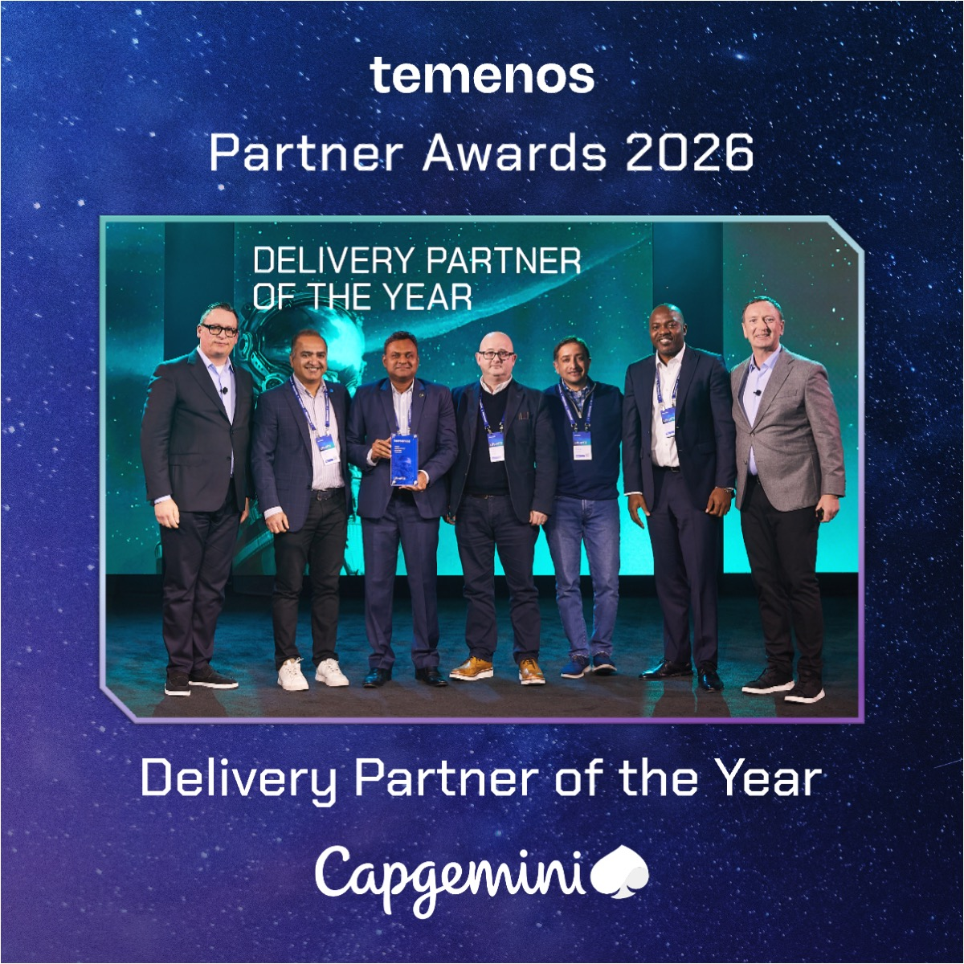
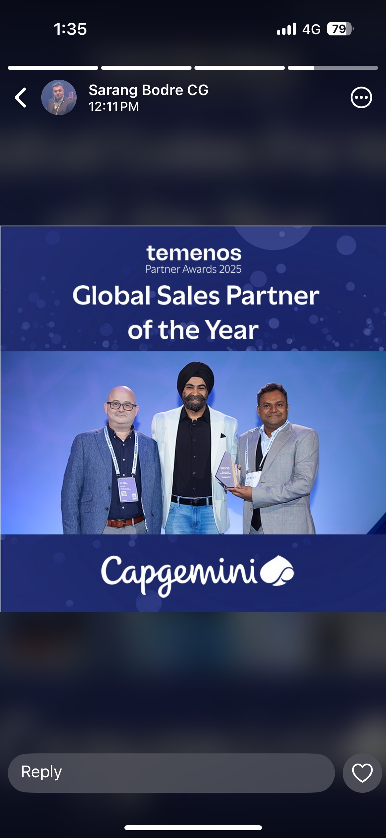
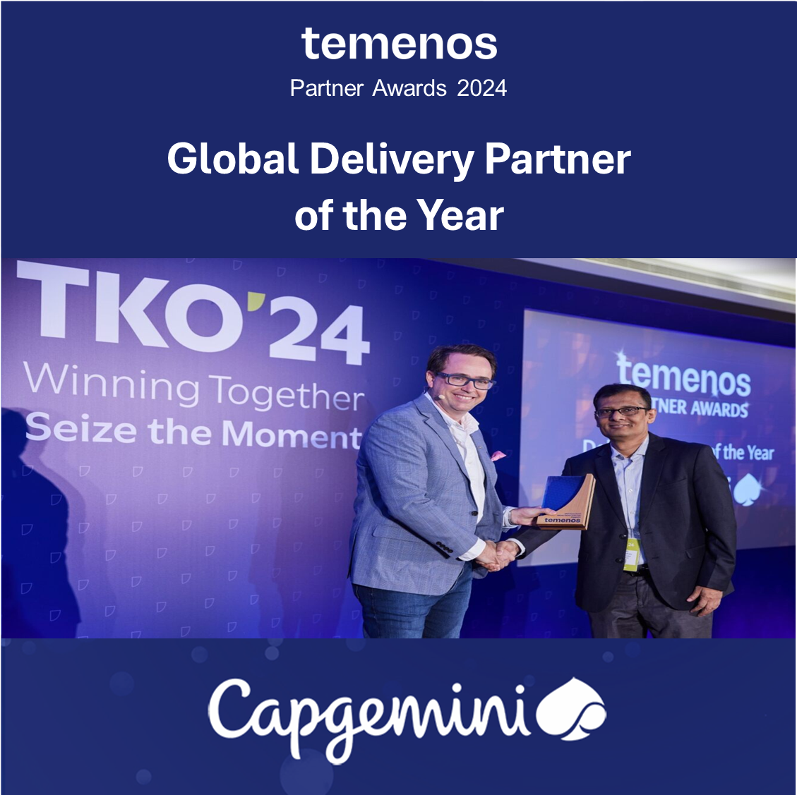
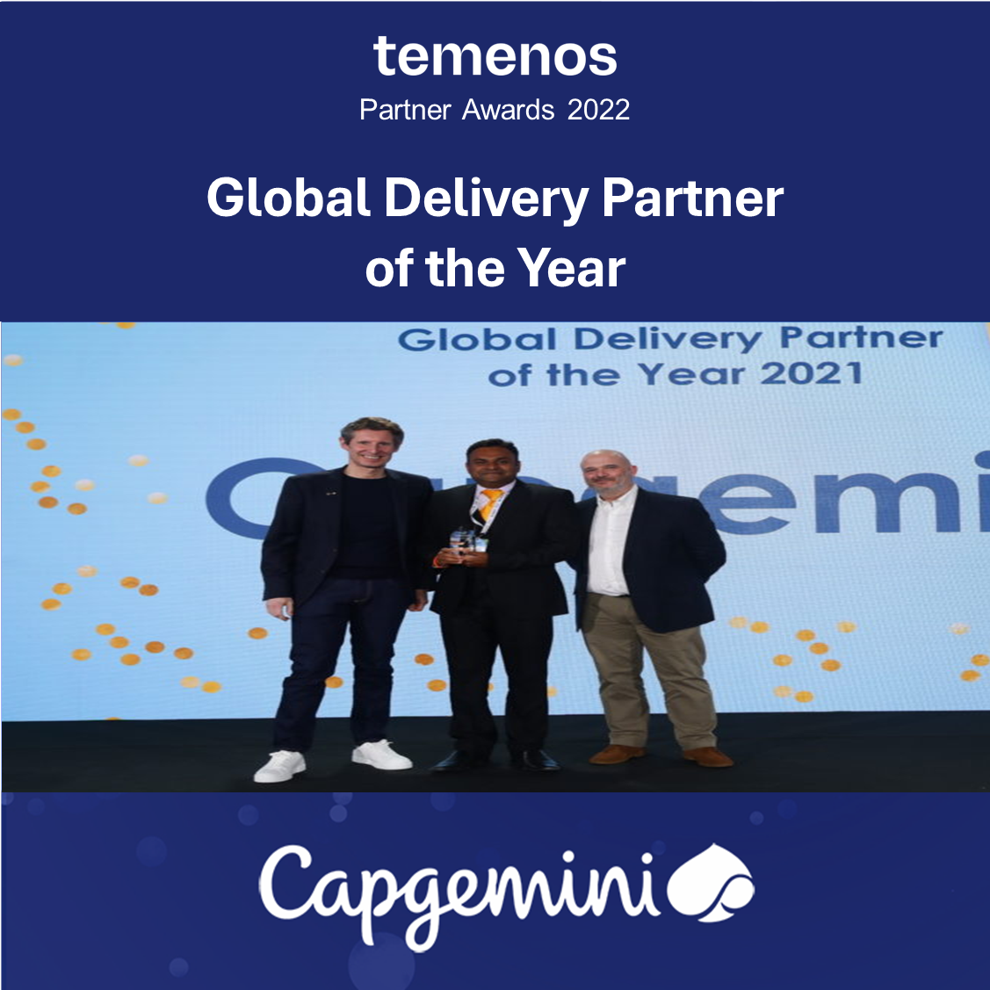
WE ARE DELIVERING EXCELLENCE FOR OUR CLIENTS THROUGH OUR EXPERIENCE AND EXPERTISE IN TEMENOS
TEMENOS PLATINUM PARTNER
25+
Active Clients Worldwide
25+
Years of Temenos Experience
900+
Experienced
ResourceS
400+
Temenos Learning Subscriptions
30+
Accelerators IPs and Repository
40+
Country Presence
Worldwide
Our Proven TPH Expertise
Highlights
Accelerated implementation through
Payment Scheme Requirement Workbench
E2E scenario and model process flow for key schemes
Payments Reference Architecture
Global Payments Business Scenario Repository
Static Data Matrix & Interface Matrix
Universal Payments Solution: Trusted partner delivering comprehensive, agile payments solution –both embedded and standalone to achieve :
Enriched customer experience
Flexible, open, real-time architecture
Regulatory compliance
Implementing Payment hub solutions in cloud and on-premises as per client requirements.
Lab environments for training & experiment, equipped with latest version of TPH & Transact
200+
Professionals with Payments experience
70+
Temenos Payments Certified Professionals
AWARDS & RECOGNITION
Temenos Delivery Partner
of the Year for 2025
Temenos Global Sales Partner of the Year for 2024
Temenos Global Delivery Partner
of the Year for 2023
Temenos Global Delivery Partner
of the Year 2021

Slide 9
WE HAVE SUCCESSFULLY DELIVERED TPH IMPLEMENTATION FOR BANKS ACROSS GEOGRAPHIES
ASSURANCE & IMPLEMENTATION SERVICES FOR TEMENOS SAAS FOR UK CLIENT
The Bank was replacing their existing Core Banking solution with Temenos Applications and were facing several challenges:
Confidence on in progress design, approach, architecture, Build (Customisations) & Hosting platform (Private Cloud vs SaaS).
concerns that the solution had multiple software components, and were complex instead of seamless platform with inter-working functions
Capgemini performed assessment that enabled client to chose the TPH solution.
Revalidation of the requirements, design and architecture documents and identify gaps which are to be plugged in for SaaS solution
To Evaluate and recommend changes in enterprise design for a solution anchored on Temenos suite
Recommendation on design and architecture, migration , reporting, financial crime mitigation, integration, data management , infrastructure and security designs was delivered
Reviewing the complete design for identified L3s on Temenos suite.
Capgemini had obtained clear understanding of Bank’s applications and interfaces, is able to visualize and document comprehensive high level solution recommendations for the target platform.
The Discovery phase ensures delivery of :
Functional Solution Blueprint
Technical Architecture
Integration Approach
Data Migration & Test Approach
TPH SOLUTION IMPLEMENTATION FOR GLOBAL CORPORATE BANK IN APAC REGION
The client was operating on a 20+ years old legacy payments system resulting in following challenges:
Higher operational costs.
Separate systems within the Bank for Foreign Payments, Domestic Payments, Inter-country transfers.
Inconsistent product configuration across branches/countries
Inability to generate reports as desired
Capgemini assisted the client in its payments transformational journey by:
Outlining detailed plan for high level fit gap analysis workshops
Designing a Payment Infrastructure Framework using TPH to handle multiple payment types
Standardizing country-model which can be replicated for other countries
Deploying Multiple Integration modes e.g., Middleware/File-based/Message-based to address various peripheral system needs
Centralizing Reporting via Insight Data warehousing Solution
With Capgemini’s solution, the client was able to achieve:
Time reduction by reusing defined process and utilization of accelerators
Fit and gap exercise to identify gaps in a time bound manner
Improve transaction tracing/reduce error by providing maker checker concept in TPH
Significant cost savings and reduction in manual work
Standardization of message formats and automatic processing in downstream systems
TPH STANDALONE IMPLEMENTATION FOR A MULTINATIONAL BANK IN AMERICA REGION
SWIFT mandate for interbank messages have changed from MT to MX messages. The current T24 R20 system cannot process MX messages.
Legacy Product
Highly customized over 20 years
Limited options for configuration
Product in TAFC
Inability to send or receive MX messages
Capgemini conducted the feasibility study/assessment of TPH and recommending a standalone implementation
Then Capgemini implemented the project successfully leveraging Capgemini best practices for Temenos implementation.
Business focused approach catering to user requirements
Adopt not Adapt to TPH functionalities as best as possible
With Capgemini’s solution, the client was able to achieve:
Process optimization for SWIFT payments and meet SWIFT deadline
To achieve Compliance to SWIFT mandate
Also lead successfully Go-Live of the project in timely manner
CHALLENGES
SOLUTIONS
OUTCOMES

Slide 10
WHY WE ARE THE BEST PARTNER TO SUPPORT YOU ON THIS CRITICAL AND STRATEGIC ENGAGEMENT
Check with Sarang
We are Temenos Platinum Partner with 25+ years of Temenos experience.
Capgemini has a dedicated centre of excellence for leading transact TPH solution build and cloud upgrade implementations
We have 900+ FTE with T24 TPH Payments domain expertise delivering projects globally
We have done TPH SAAS upgrades for XX number of customers.
TPH expertise and capabilities
TBF
Knowledge of Temenos cloud foundation
We have a well-established presence in most of the geographies that can be leveraged by DZ Bank, particularly nearshore locations
We are ready to support roles in a hybrid location model to best cost-benefit outcomes.
We have done various Temenos engagements in these 4 countries (Singapore, Hongkong, US, UK) and have the regulatory knowledge
Multi geography presence and knowhow
We have an extensive array of accelerators on payment flows and T24 TPH and use cases that we have accumulated over decades of implementation experience. We will bring this into delivery for more coherent outcomes.
Our delivery methods and approach is tailored to provide the right outcome for your program
Methods, tools and accelerators
We have the ability to onboard SMEs and technical consultants to start working with Bank & Temenos on day 1
Ability to start immediately

Slide 11
OUR scope of services

Slide 12


WE UNDERSTAND THAT DZ BANK REQUIRES HANDHOLDING DURING THE TEMENOS UPGRADE PROJECT
DZ Bank is planning to engage Temenos for the TPH upgrade and cloud migration. As part of this RFP, they are looking for a certified Temenos partner to provide strategic consultancy and expert oversight to ensure the successful delivery of the TPH Upgrade Program.
In Scope
Program Management & Governance
Support in program management activities across stakeholders
Co-ordinate workshops to finalize requirements/plan/approach/ walkthroughs
Review program progress, risks, and dependencies
Help DZ Bank in adherence to timelines and governance processes
Consulting/Advisory Services
Analysis for Temenos upgrade preparation.
Provide subject-matter expertise on Temenos TPH upgrade to help minimize L3 customizations and integrate “Mission International” functions
Advise on best practices, architecture, and implementation approach
Review the configuration packages delivered by Temenos
Review the project deliverables produced by Temenos against functional, technical, and regulatory compliance requirements.
Provide independent advice, feedback and recommendations to maximize efficiency.
Assist DZ Bank teams in evaluating deliverables and solution components.
Out of Scope
Upgrade implementation including configuration, testing
Integration with other systems
Program management for end-to-end program
Support for modules other than TPH
Cloud Migration/Assurance
Review of existing defects in R22
Performance Tuning activities
Expected deliverables as given in Sec 15 of RFP other than those mentioned in the slides*
* As per our understanding the documentation requirements mentioned in the scope of the RFP is typically done by Temenos

Slide 13
WE WILL ALIGN WITH IMPLEMENTATION APPROACH AND PROGRAM PLAN AGREED BETWEEN DZ BANK AND TEMENOS
We will align with upgrade plan agreed between Temenos and DZ Bank and provide skilled Temenos TPH SMEs to support the upgrade journey from R22 to R25 by delivering consulting and advisory services. Our team will be integrated across all key upgrade phases —Analysis, Upgrade and retrofit activities, Testing, and Go‑Live.
Program Governance
Analysis
Upgrade/
Build
Testing
Preparation & Go-Live
Analyze Inventory of all local developments & integration points.
Participate in workshops and guide Bank and Temenos on the solutions (back to core/upgrade retrofit)
Provide consultancy (limited to TPH regionalized solutions) on regulatory requirements for the 4 countries in scope
Review and advise on the changes to be done by the Bank based on upstream/downstream impacts
Review Back to Core/ Upgrade/ Retrofit design/ approach finalized by Temenos
Review Technical Upgrade Activities/Runbook
Review configuration packages
Review Mock Upgrade results & suggest Improvements
Review Back to Core/Retrofit build packages
Review Interface & API alignment
Participate in workshops and guide Bank and Temenos to define reconciliation strategy
Review upgrade performance timelines and highlight the challenges
Participate in workshops and guide Bank and Temenos on the testing strategy/approach
Review reconciliation conducted post upgrade
Review Back to Core/Retrofit build test results
Guide users in UAT testing approach
Review Production cutover plan & Rollback readiness
Review upgrade runbook/release plan
Review handover documents
Validate Monitoring results and suggest improvements
Validate stabilization & optimization activities
We will provide : Reports from reviews conducted; Reviewed study concept documents, Recommendations, Insights during all phases of the program.

Slide 14
WE WILL SUPPORT IN KEY ACTIVITIES IN ALL THE PHASES TO ENSURE AN EFFICIENT AND SUCCESSFUL TPH UPGRADE PROGRAM
Phase | Key Activities | Reports
Program Governance | Setup a DZ Bank-Temenos-Capgemini tripartite Governance Process Align on the RACI matrix Coordinate with key Stakeholders to finalize requirements/walkthroughs Coordinate with key Stakeholders for smooth delivery of services Review project plan provided by Temenos and Bank and ensure adherence Participate in weekly/monthly meetings | Project progress Reports
Analysis | Analyze Inventory of all local developments & integration points. Participate in workshops and guide Bank and Temenos on the solutions (back to core/upgrade retrofit) Provide consultancy (limited to TPH regionalized solutions) on regulatory requirements for the 4 countries Review and advise on the changes to be done by Bank based on upstream/downstream impacts Review Back to Core/Upgrade/Retrofit design/approach finalized by Temenos | Reports from reviews conducted
Upgrade/Build | Review Technical Upgrade Activities/Runbook Review configuration packages Review Mock Upgrade results & suggest Improvements Review Back to Core/Retrofit build packages Review Interface & API alignment Participate in workshops and guide Bank and Temenos to define reconciliation strategy Review upgrade performance timelines and highlight the challenges | Reports from reviews conducted
Testing | Participate in workshops and guide Bank and Temenos on the testing strategy/approach Review reconciliation conducted post upgrade Review Back to Core/Retrofit build test results Guide users in UAT testing approach | Reports from reviews conducted
Upgrade/Go-Live | Review Production cutover plan & Rollback readiness Review upgrade runbook/release plan Review handover documents Validate Monitoring results and suggest improvements Validate stabilization & optimization activities | Reports from reviews conducted

Slide 15
OUR EXPERTS WILL ASSUME KEY ROLES AND PERFORM THE ACTIVITIES NEEDED TO SUPPORT DZ BANK ON ITS MISSION
Based on our current understanding of our scope for this engagement we propose a team of resources with the following roles and headcounts. However, we are flexible to adjust this estimation in discussion with DZ Bank for the success of the program.
Role | Role Description | FTE
TPH Upgrade Program Manager | Setup a Governance Process – Operational, Tactical & Strategic Planning, Monitoring & Tracking for Temenos Activities Coordination with Temenos and DZ Bank Stakeholders Co-ordinate workshops to finalize requirements/walkthroughs etc., Review project plan based on inputs from temenos and Bank [phased approach] Validate backup & rollback plan with Temenos Validate Go-Live & post implementation plan with Temenos | 1
TPH Functional SME (UK) | Participate in workshops and guide Bank and Temenos on the solutions (back to core/upgrade retrofit) Review and advice the changes to be done by Bank based on upstream/downstream impacts Review the design changes Review the configuration/gap packages delivered Review reconciliation conducted post upgrade and suggest improvements. Participate in workshops and guide Bank and Temenos on the testing strategy/approach Review test cases based on solutions finalized Review the test results | 1
TPH Techno Functional SME (UK/India) | Review Technical Upgrade Activities Review Mock Upgrades &suggest Improvements Validate Back to Core/Retrofit assessment Participate in review discussions and suggest improvements. Review upgrade performance timelines and highlight the challenges. Validate Interface & API alignment Validate performance tuning | 2
TPH Upgrade Analyst (India) | Review Inventory of all local developments technically Validate Back to Core/Retrofit requirements Review Data model migration. Review data growth and transaction volume characteristics | 1
PMO Analyst (India) | Review project plan based on inputs from temenos and Bank Schedule workshops to finalize requirements/walkthroughs etc., Create various reports and submit to stakeholders. | 1

Slide 16
IT IS CRUCIAL TO JOINTLY AGREE ON A RACI MATRIX UPFRONT FOR SUCH A TRIPARTITE ENGAGEMENT
This is a sample RACI Matrix. We will align and jointly prepare the RACI matrix- with DZ Bank and Temenos before engagement start.
SN | Activity | Capgemini | DZ Bank | Temenos
1 | Prepare Project Plan, manage project, review progress, report status and update plan | I | R,A | C,I
2 | Provide & Manage Upgrade Environment, all other tools setup and access (TPH Latest release, h/w and s/w as per the latest release) | C,I | C,I | R,A
3 | Manage all the third-party Consultants and timely resolution of issues and support - during project, live and post live periods | C,I | R,A | R
4 | Escalate any issues identified to Temenos on timely manner | C,I | R,A | R
5 | Temenos Governance | C,I | R,A | R
6 | Deploy and unit test the Temenos patches limited to Upgrade | C,I | C,I | R,A
7 | Upgrade Production Execution – TPH | C,I | C,I | R,A
8 | Upgrade Production Execution – Other than TPH systems | C,I | R,A | C,I
9 | Release management & Environment Management (R22 and R25 SIT env onwards) | C,I | C,I | R,A
10 | Application Support post warranty support | C,I | C,I | R,A
11 | Gap List Review & Sign-off | C,I | R,A | R
12 | Review Functional, Technical and Integration Design document | R | R,A | R
13 | Configuration, Customization Build, Unit Testing of Additional Transact products/modules/L3/Integration/Upgrade Build | C,I | C,I | R,A
14 | Test Strategy​ and Planning, Test design - E2E Testing – SIT, UAT, NFR | C,I | R | R,A
15 | Fixes for Defects in the base product (L1/L2) | C,I | C,I | R,A
16 | Fixes for defects in the Customization (L3) | C,I | C,I | R,A
17 | Cut Over and Go Live | C,I | C,I | R,A
R – Responsible, A - Accountable, C - Consulted and I - Informed

Slide 17

TO MANAGE THE UNKNOWNS, WE HAVE MADE SOME ASSUMPTIONS FOR THIS OFFER
These are the assumptions we have made based on our experience and understanding of the requirements.
Temenos will provide a read only access to validate configurations.
Capgemini will onboard the resources based on high level plan agreed between Temenos and DZ Bank.
Capgemini will not engage in Bank’s non-Transact asset review /build/ documentation work.
Capgemini will not be part of any build related activities such as retrofit/reconciliation, integration, gaps, etc.
Capgemini will not be part of any testing activities like UT, ST, SIT, UAT, etc.
Capgemini will not be engaged in Cloud implementation and its review process.
Bank to provide Business users operations SME and technical staff for the overall program activities.
Bank to provide timely signoffs on plans, designs, requirements, design activities and artefacts
Required environments (for Development/Unit testing/Training) including Masked environment and on need basis production access) to be provided by Bank
Availability of Hardware/Software, Internet connectivity, Telephones, Tools, Workstations for the Capgemini onsite resources
DZ Bank to provide all documentation related to existing TPH R22 application, customizations, source systems and any other documents at the start of the project including specifications, process and procedures
DZ Bank to provide support in explaining functionality of current release during test preparation phase

Slide 18
OUR COMMERCIAL PROPSITION

Slide 19
WE PROPOSE AN ATTRACTIVE AND FLEXIBLE TIME AND MATERIAL COMMERCIAL OFFER
In view of our current understanding of the requirements and scope for this RfP, Capgemini proposes a T&M engagement based on our existing MSA with DZ Bank group. This enables DZ Bank to engage Capgemini team flexibly in case of change in requirements or scope.
The number of resources for each role and seniority and the duration of their engagement will be mutually agreed with DZ Bank.
As there is no constraint on location or language, we propose majority of the team to be comprised of our Temenos experts from India to optimize the cost for DZ Bank. The team will be flexible to operate in the Timezone of DZ Bank if needed.
The team will be led by a TPH Techno-functional expert based in UK for client proximity and in-person interactions and will act as the bridgehead to our offshore team.
Role | Level | Duration | LOCATION | Daily rate (EURO/DAY)
EXPERT | 4 | 01.04.2026 -30.11.2026 | UK | 2.100
EXPERT | 4 | 01.04.2026 -30.11.2026 | INDIA | 400
SENIOR CONSULTANT | 3 | 01.04.2026 -30.11.2026 | INDIA | 350
CONSULTANT | 2 | 01.04.2026 -30.11.2026 | INDIA | 275
Commercial Assumptions
The daily rates are applicable for 8hrs of effort. Local holidays are applicable.
The services by the Capgemini team will be performed primarily at Capgemini's offices and/or via home office from the base location of the Capgemini personnel. Coordination meetings and further discussions will take place via video conference. In addition, based on mutual agreement, workshops may be held in the DZ Bank offices in UK.
Invoicing will be done based on actual effort at the end of each month.
Above prices are exclusive of the respective applicable statutory value added tax.
The offer from Capgemini is valid till 31.12.2026
The Rate Card proposed here is applicable only for this RfP and for these roles/seniorities for 2026. For engagement beyond 2026, the Rates maybe revised.
We require a 6-week resource onboarding time after contract signature.

Slide 20
OUR INDICATIVE TEAM

Slide 21

TPH UPGRADE PROGRAM MANAGER
Experience Highlight
Temenos – 10 Years of experience
Professional summary
Experience
An experienced T24 Programme Manager with over 17 Years’ experience in Banking Software implementation projects.
Experienced in Business Change Transformation
Experienced in end-to-end delivery of Projects, establishing and maintaining the correct structures to control and monitor the deliverables to the stakeholders, including where appropriate the delivery of the target operating model.
Managed third party relationships ensuring that dependencies are identified and managed and deliverables are achieved, as defined in the project plans and without incurring unnecessary cost or delay to the project.
Good knowledge of Business process engineering, IT Service Management Delivery, Joint Application Design, Process maps, Voice of Customer methodology, Interviewing, Story Boarding, Focus groups and other requirement gathering techniques..
Experienced in various implementation methodology but my approach is to align best practices with the client chosen methodology
Capgemini, Portfolio Manager : Responsible for creating an end-to-end delivery approach for new business opportunities, Managing T24 implementation, Scrum Master for T24 Agile Projects, supporting new opportunities, T24 Design solutions, Coaching and Mentoring T24 consultants.
Temenos, Client Engagement Manager (UK & Ireland): Responsible for creating an end-to-end delivery approach for new business opportunities for both new and existing clients. This involves understanding the client’s strategic business and technology goals and aligning these Temenos services and solutions.
Cognizant, Senior Manager, Projects: Delivery Lead for the T24 implementation and support activities for a Large UK bank. Managed a dual shore team of ~25 team (across London, Manchester, Jersey and India; budget ~ £5M) in various projects of T24 system.
Temenos, Programme Manager: Managed various T24 transformation projects globally covering Retail, Corporate, Wealth and Digital with budgets ranging from £5M - £7M.
Regional Customer Support Manager(UK & Ireland): Managed the first point of contact desk for all implementing and Live Clients.
Temenos Principal Consultant: Responsibility for the overall solution design on a project from the Pre-Sales scoping process and through the implementation, at key stages on the project
WD
TPH Upgrade Program Manager
Experience Attribute
Specialist: Project Management (planning, scheduling, controlling and reporting), T24 banking software Implementation, Business and digital transformations, Agile/Waterfall/Lean project delivery methodologies.
Personal: Proactive global leader and supportive team player, Retail and corporate banking sectors, experienced in all aspects of project management.
Others: Requirement analysis, Data Migration Management, Defect Management, Stakeholder Management, 3rd party vendor management, functional and technical design documentation, Process Mapping, Service Delivery, Gap Analysis
Education
B.SC, M.SC (Computer Sciences)
ITIL v3 Foundation certified, ITIL Service Strategy,
PSM I, PMI-PMP, PMI-ACP, MSP
SAFe Agilist , PO/PM, Senior Scrum Master
PMI Organisational Transformation – Foundation, Implementation

Slide 22
TPH FUNCTIONAL SME
Experience Highlight
Banking Experience– 18+ years
Professional summary
Experience
18.5 Years of experience in banking product development & technical architecture
Implementation across wide range of banking and financial services products for Europe, Middle East, APAC & LATAM regions.
Experience in variety of products from various core banking solutions (retail and corporate) , payment solutions and digital banking.
Experience in doing technical architecture, E2E integration architecture & data architecture for various core banking transformations
Experience in Microservices based architecture, API’s, integrations using event driven architecture based on KAFKA, MQ, ESB
Experience in Data Migration from Mainframe System to Core Banking, Transact to Transact Migration
Experienced in aligning business goals with technology solutions to drive process improvements
Define business process, identify the risk, and providing baseline acceptance criteria
​
Enterprise Architect – UK Client
Responsible for the overall solution across Temenos Suite of apps (Transact, TPH, Infinity, FCM, TDH) and the surrounding systems
Impact analysis, interface analysis, data analysis and definition of Target State Architecture
Owning the Complete Solution Blueprint document.
Defining the solution for complete payment journey on TPH, Data Flow for TDH, Including Migration Strategy to Transact.
Senior Solution Architect – Geneva Client
Responsible for doing technical, DEVOPS, and E2E integration for a multi country core banking implementation on microservices architecture.
Impact analysis, interface analysis, data analysis and definition of Target State Architecture
Own the Complete Solution Blueprint document
Senior Solution Architect – Kuwait Client
Responsible for creating End to End Integration architecture and entity relationship for the solution blueprint document.
Definition of Rest API and Events based pattern
Involved in setup of design office & part of architecture review board
Providing technical guidance to application development teams.
Migration Architect – Ireland Client
Delivered and Implemented Data Migration from old Legacy system to new core banking.
Migration Solution, strategy Documents, Mapping workshops & Technical Solutions
Designing the Co-Existence Architecture with integration using Mule soft between Legacy and New core
Migration Lead – Finland Client
Delivered and Implemented Data Migration from old core to new core.
Migration Solution, strategy Documents, Mapping workshops & Technical Solutions
Techno Functional Lead – UK Client
Delivered and Implemented core banking transformation programme with multiple interfaces, integrations across multi company setup in core banking.
Lead the implementation & design of Payment gateway Solution, STP for faster payments, SEPA, BACS and CHAPS payments ,integration with old legacy product systems
AKM
TPH Functional SME
Experience Attribute
Solution Architect
Data Migration
Techno functional Lead
Core Banking Transformation
Business Analysis, Business Process, Requirement gathering & Domain Expertise
Product knowledge of various packages in core banking retail & corporate,
Payments BACS/CHAPS/SWIFT & Clearing/Settlement (ACH/SEPA)
Temenos Payment Hub
Transact Data Hub
Education
Bachelor Of Engineering
Diploma Graduate

Slide 23

TPH FUNCTIONAL SME
Experience Highlight
Banking Experience– 25+ years
Professional summary
Experience
Banking & IT Industry SME– 25+ years
More than 15 yrs of experience as Principal Business Analyst, proven track record in Project Delivery, Requirement gathering, Elicitation, solutioning, migration and implementation of Enterprise technologies in a large-scale, complex banking projects. Have worked in multiple projects that includes migration of legacy applications to digital transformation in Bank in UAE, development of conduct risk application for UK Bank, solutioning of complex business requirements to meet functional and non-functional requirements
Functional SME: Support project delivery for Japanese-APH project. Managed T24 upgrades, enhancements for Mauritius, Bank US, etc. involving TPH, AA, Securities. Tracking the issues and enhancements to closure, providing periodical status updates to clients, ensure solution meets the requirements through specific enhancements, working on core issues, ensure past enhancements are factored retrospectively into upgrades, etc. Manage environment readiness, testing cycles, go-live, Day0 readiness, End user journey, Customer journey, legacy migration, meta/static/transactional data migrations, GL Accounting/Balance Sheet adjustments, Reporting. Ensure post go-live support and Manage blocker and critical issues within SLA.
Principal Business Analyst: Conduct requirement gathering/brainstorming sessions, manage BA team and ensure completion of user stories for conduct risk application(Bank in UK), work with Development and Testing team and provide guidance to design, ETL, Data modelling. Work with business user, manage user trainings. Create detailed Requirement Definition, review test scenarios.Liaise with Intellect, GLCMS, T24, OneSumX, OFSAA for exécution of mock migration(FAB) and ensure balance sheet adjustments and corrélations are managed. Worked on client reports, visualisations, Dashboard. Create Use cases for US Loan Origination processes (Bank in US). Manage enhancements, issues, releases. Conduct weekly triage calls with bank and guide the technical team for solutions.
PRK
TPH Functional SME
Experience Attribute
Strong techno-functional experience in core banking platform - T24 (Securities, Derivatives, Structured Products, TAP, AA, TPH)
Domain experience in Retail banking - Payments, Lending; Corporate Banking, Investment Banking
User Training, Product Management, Defects Management (SLA tracking), Upgrades, Enhancements, Data Migration, UAT, End to End product implementation.
Education
Chartered Financial Analyst (ICFAI)
Certified Associate of Indian Institute of Bankers (IIBF)

Slide 24
TPH TECHNO-FUNCTIONAL SME
Experience Highlight
Temenos (TPH) – 14 years with 7 transformation programs
Professional summary
Experience
Seasoned Banking SME and Payments/Wealth Management/Trade Finance/Retail Banking professional with over 18 years of expertise in solutions, consulting, testing ST/SIT/UAT/ and project delivery.
Specialized in PAYMENTS like SEPA. Instant Payment, cross-border, and domestic clearing implementations, Euro Digital Currency Simulation,
Proven track record with Temenos Payment Hub implementations, interfacing with systems like FNP, Corona, and Fircosoft, and managing complex configurations. Basic Understanding of Euro Digital Currency
Versatile experience with multiple payment products such as Temenos Payment Hub R24, Fircosoft, Flex cube, and GPP.
Deep understanding of core payment processing and end-to-end workflows (both real-time and batch processing) which includes ISO2022
Expert in financial messaging standards – SEPA, BACS, SWIFT MT , CHATS,
Thorough knowledge of all phases of the Software Development Life Cycle – proficient in Agile SCRUM and Waterfall methodologies.
Identified inefficiencies in journeys and automated solutions, boosting NPS by 5%
Bank in Germany Payment Implantation with SEPA MT to MX – Techno-functional SME
Contribute as Payments SME for Temenos Payment Hub upgrade.
Defined the New Versions features comparison of Payment engine which ban need to upgrade for SEPA instant SEPA classic and MT to MX
TPH MX Configuration Validation along with worked on TPH R21 Mapping Sheet and Documentation alignment
Collected Requirement for SEPA instant for TPH.
Supported Testing team in static data and defect fixing.
Fixing the production defect for TPH and developed the new version and additional filed via configuration.
Bank in Japan & Hongkong CHATS.SWIFT,MX Payment implementation TPH – Techno-functional SME
Translate business requirements into solution documents.
Create flows for requirements and user stories in Jira..
Develop TPH and T24 enquiries and versions for L3 development.
Configure TPH and T24 as per requirements.
Set up T24 system parameters, payment connection methods, and payment processes in TPH.
Implement fraud checks and sanction filtering in TPH.
Automate treasury rates and set up currency limits in T24.
Create solution specification documents for interfaces with T24 R21-TPH-GPP..
Provide walk-throughs of functional specification documents to teams.
UBS Bank (Zurich)Payment Migration for SEPA/SWIFT/TARGET2 – Techno-functional SME
Liaised with business group, assessed their requirements and identified gaps.
Analysed the gaps for workaround solution
Created BRD for T24 (Temenos Payments Hub) implementation
Actively participated in resolution of defects raised by business partners
Ensured to keep all stakeholders, vendors and higher ups informed about status of ongoing activities.
AKS
TPH Techno-Functional SME
Experience Attribute
Lead business requirements elicitation, backlog grooming, analysis, and documentation, including the creation of epics and user stories.
Microsoft Office (MS Word, Excel, PowerPoint)
Payment's product(SEPA/BACS)
Project Management – Jira
Stakeholder Management
Regulatory Compliance
KYC and Due Diligence
AI in Banking Payments
Agile framework
Education
Master In Foreign Trade Specialisation in International Finance
Certified Product Owner Scrum Alliance
Temenos Certified in Payments
Certification of Capability in Business Analysis.
Fraud Crime Management and Know Your Customer certification

Slide 25
TPH TECHNO-FUNCTIONAL SME
Experience Highlight
Temenos (TPH) – 10 years of experience
Professional summary
Experience
Having 10+ years of overall industry experience and 10 years 2 months of experience in Temenos T24 products
Sound knowledge and good understanding on ISO payment messages & standards, SEPA and US Payments - ACH and Fedwire
Sound knowledge in T24 customizations like versions, enquiries, multi thread routines and template creation
Sound knowledge in TPH, IRIS, AA, Interface and TAFJ
Sound exposure in preparing technical specification documents for gaps and Interface
Working in latest releases of TAFJ from R13 to R23 with good hands-on experience
Worked in various modules like Retail banking, Corporate banking, Arrangement Architecture, Data Formatting Engine and Temenos Payments Hub
Having good exposure to Agile methodology working style
Hands-on experience in Java coding & 3+ years Temenos Cloud environment
Transact Integration – Aug 2024 to Present
Involved in orchestration of design pattern for integrating Transact with other external systems
Techno functional SME for TPH implementation
Manage team members for quality deliverables in a very stringent timelines
Transact/TPH Consultant - Apr 2024 to Jul 2024
Supported business in gathering requirements and use cases for Target Instant Payment System
Designed configurations for TIPS clearing
Conducted workshops with client on understanding of configurations
Coordinated with other teams to streamline the payment flow
Transact/TPH Consultant - Sep 2022 to Jan 2024
As a lead, responsible for configuration & requirements gathering of SEPA CT and SWIFT messages
Worked in configurations and generation of messages as per iso20022 message standard
Managed local customizations in handling various types of payment messages
Handled the deliverables of Technical documents and components
Worked on latest release R23 embedded in Temenos Cloud
Process improvement and knowledge sharing initiatives across different teams
Guided and worked as a team to get the work done in the stringent timeline
Played a consultation role to bank users in TPH and supported for go-live
DBR
TPH Techno-Functional SME
Experience Attribute
Strong Temenos Payments Hub expertise
Domain knowledge of Payments
Strong Temenos Transact & IRIS expertise
Education
B.Tech – IT, KLN College of Information Technology, 2007-2011

Slide 26
TPH UPGRADE ANALYST
Experience Highlight
Temenos– 21 Years, across 5 transformation programs
Professional summary
Experience
Twenty plus years of experience in Financial Services focused on Private, Wealth and Retail Banking
Worked with several large-scale banks in UK, Europe, Hong Kong, Singapore, UAE and Southeast Asia Regions. Played vital roles in various complex nature of implementation, Data Migration, Upgrade, Maintenance and Customization projects
Subject matter expert in T24 - Technical and Banking Functional aspects, requirement gathering, analysis, design and overall Functional and Technical solutions
Proficiency in Delivering Complex Engagements
Delivery Lead – Nordea Bank, Finland- Support for Non-Core developments and Non-Prod environments. Develop and Implement new tools and utilities like Splunk dashboards which will help the Solution Delivery and Production Support teams. User Agent and Transact Performance issues with the help of Splunk and App Dynamics. TEX Training and build-up the team
Lead – L3 Customization, Integration and Data Migration for EastWest Bank, Philippines T24 Implementation- Leading L3 Customization, Interfaces Integration and Data Migration streams for EastWest Bank Implementation
Delivery / Tech Lead for Morgan Stanley T24 Projects- Delivery / Tech Lead for T24 Projects and Run The Bank Deliverables for Morgan Stanley Singapore and Hong Kong T24 Instances. Various critical and regulatory requirements were delivered on-time. Tech-Lead for the Upgrade from R09 to R19 Release
Automated Data Migration, Verification and Reconciliation Tool for Morgan Stanley- Delivered an Automated Tool for Transferring the Clients’ Assets from Singapore to Hong Kong which significantly reduced the manual intervention during the Migration Activities. With the help of the tool the Migration process became a BAU Activity and currently handled by L3 team
Implementation of MSAIL Singapore and Hong Kong Entities for Morgan Stanley- Design, Plan, Manage and Deliver the Implementation of MSAIL Singapore and Hong Kong Entities. Analyzed various downstream and upstream system impacts and designed the changes accordingly
SS
TPH Upgrade Analyst
Experience Attribute
Engagement Delivery
Business Analysis
Implementation and System Integration
Data Migration
Domain expertise in Private, Wealth and Retail Banking
Requirements Gathering
Process and Solutions Designing
Customized Solutions, Performance Tuning
Techno Functional expertise
Platform Transformation
Expertise in T24 Architecture
Education
Bachelor of Commerce
TLC Certifications

Slide 27
Your Contact Partner
Avik Dutta Chowdhury
Account Executive
Capgemini Deutschland GmbH
Financial Services
Mobile: +49 1512 0322 628
avik.dutta-chowdhury@capgemini.com

Slide 28
APPENDIX

Slide 29











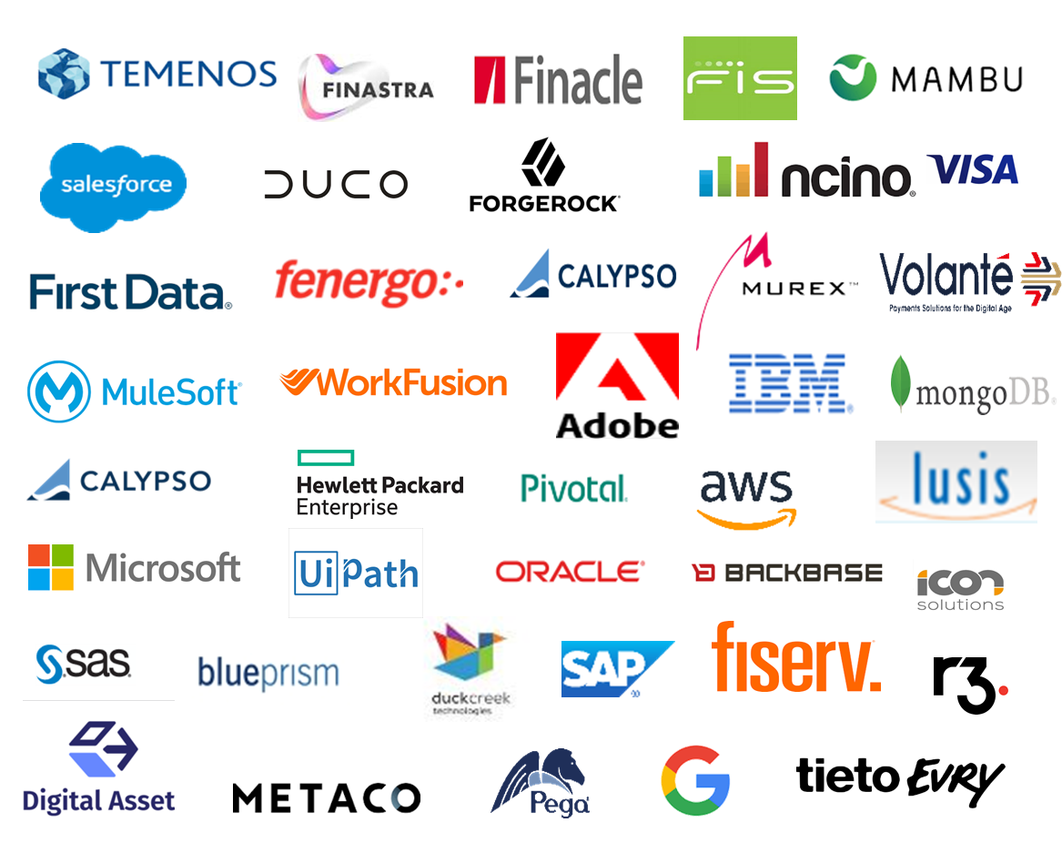




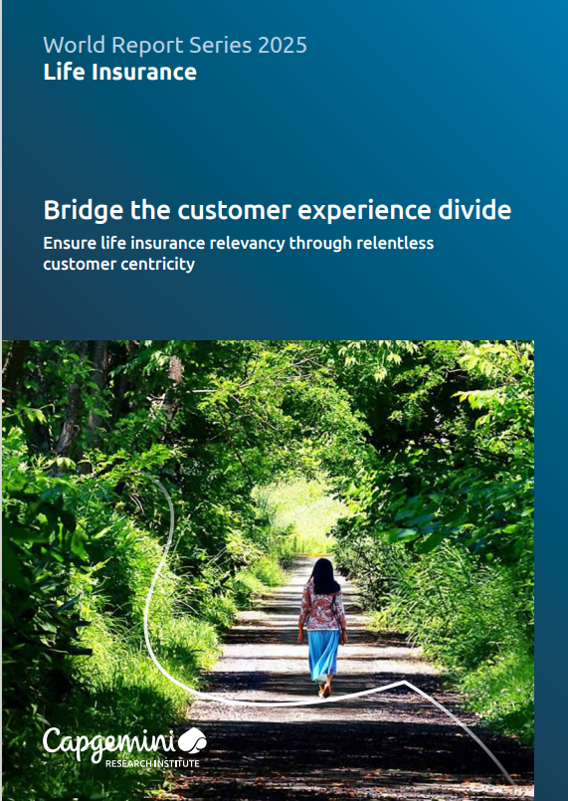







Our Banking & Capital markets Capabilities
We partner with our Banking and Capital Markets clients to enable them to meet customers’ digital expectations, manage risks, and attain sustainable business practices
Robust, integrated and industrialized multi-client delivery center
AIMiLi0 – the Digital Operations Platform (DOP) bot for intelligent automation
Dedicated Center of Excellence for Core Banking, Cards & Payments, Capital Markets and Wealth Management
100 + IP and Solutions
Technology and Banking Products Partners
A Comprehensive Service Portfolio
Connected Banking Reference Arch - Setup a greenfield bank
PSD2 and CMA compliance software
GDPR Compliance
Data Migration - Workbench, Xpress migration
Merchant Tokenization & EMV Toolkit
ADAPT – Adaptive Test Automation Framework
Application Dev. and Maintenance
Insights and Data
10
SI & Package Implementation
Domain Advisory
of the top 15 Banks
Robotic Process Automation
Testing Services
41000+
Architecture & Design
Upgrades and Support
associates
Regulatory & Compliance
Digital Services
Thought Leadership
Recent Acquisitions
Recognition
2024 World Wealth Management Report
2024 World Retail Banking Report
2025 World Payments Report
9 of the top 15 diversified financials firms
8 of the top 10 investment banks

Slide 30












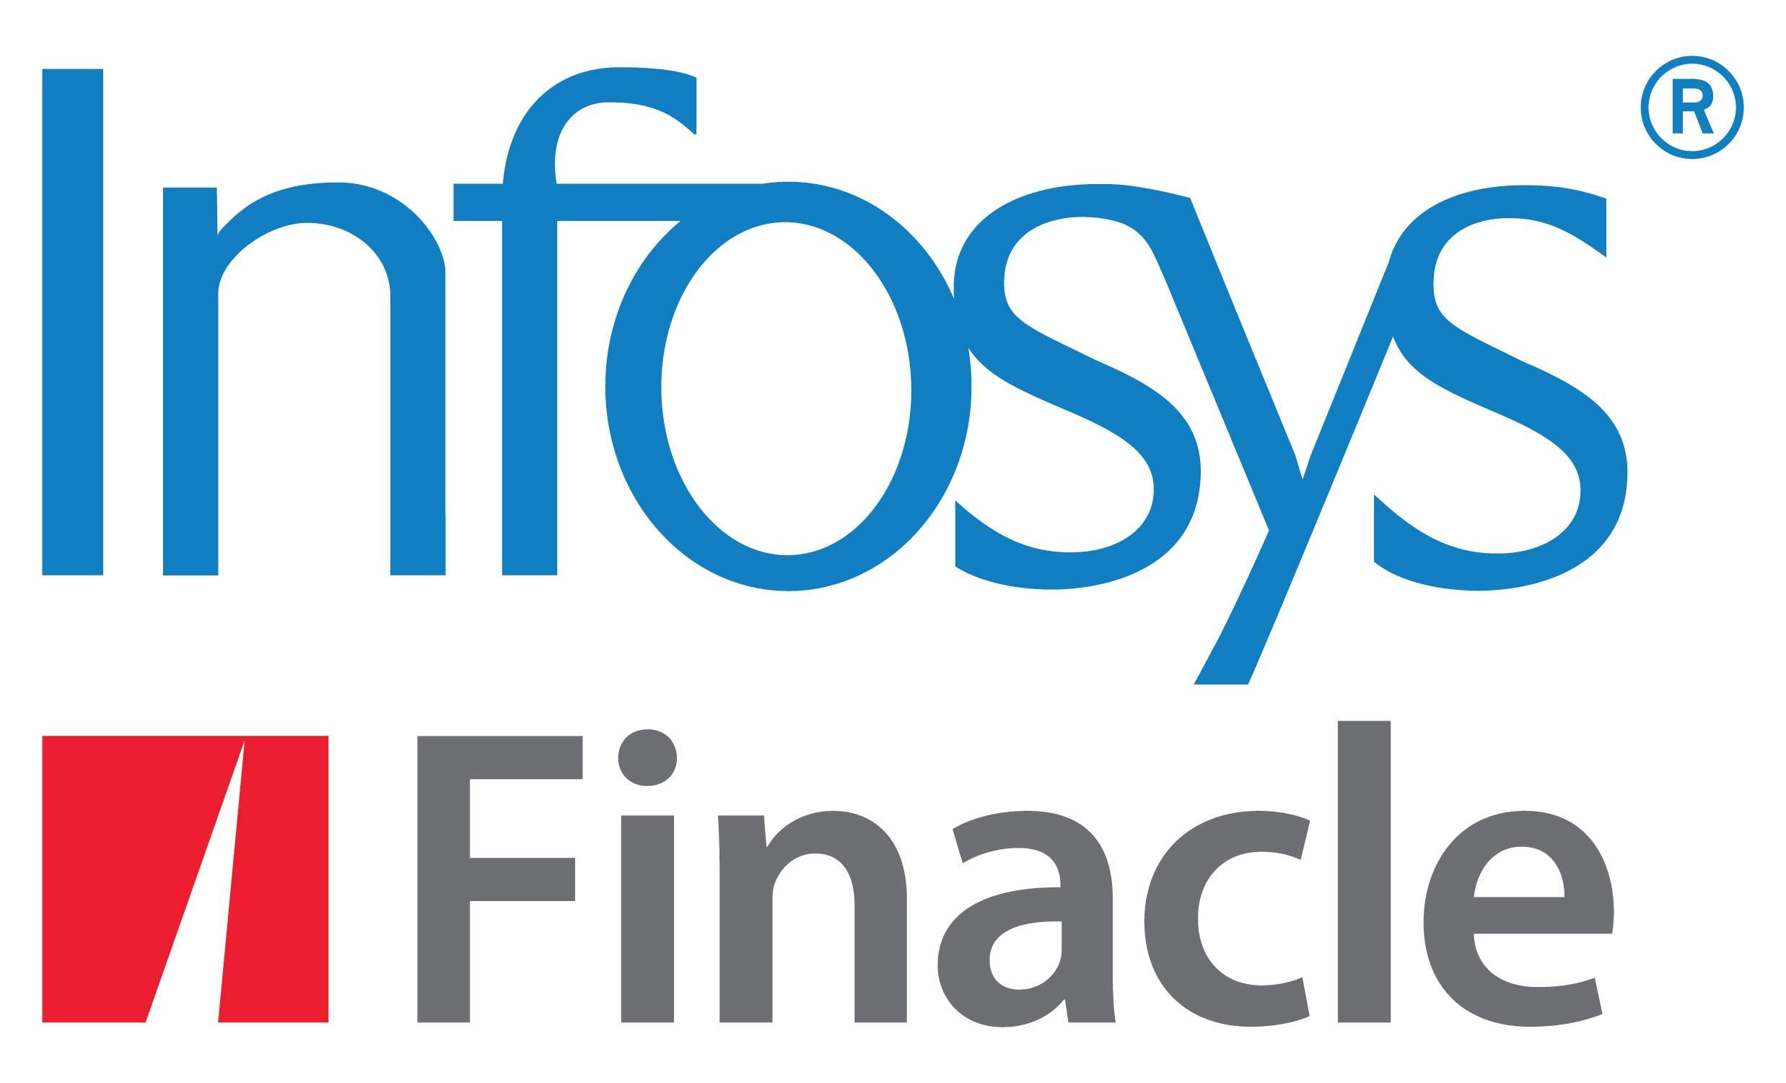

WE HAVE THE DOMAIN EXPERIENCE THAT DRIVES BUSINESS VALUE
Banking Domain Practice
Retail Banking
Savings and Current Accounts, Deposits, & other services
Retail loans, mortgages, personal loans, debit or credit cards
Multi currency accounts, certificates of deposit
AML & Fraud Check
Corporate Banking
Corporate Customers & Accounts
Deposits & Lending
Treasury & money markets
Payments & Cash Management
Trade Finance & Supply chain Management
Wealth Management
Relationship Manager & Client Channels
Advisory & Discretionary Portfolio Management
Order & Trade Life cycle
Custody & Lifecycle Management
Market & Reference Data Management
Diversified Financials
Auto Leasing
Asset Finance
Complex lending
Highlights
Core Banking Practice Presence Around The Globe
Tools & Accelerators
Delivered 125+ core banking projects
US & Canada 200+
UK & Europe 330+
CBRA & CIBOK tools
Connected Banking Reference Architecture & Process Models
CADMIS- Data Migration Solution
ADAPT- Test Automation Framework
50+ tools, accelerators and reference architectures
40+ country presence
worldwide
Asia-Pacific 1500+
Innovations
BIAN Aling Interface offering
Gen AI Tools
XAI based Early Warning System
Reusable Integration layer for Core banking data transformation
Automated Health Check & Self-service portals
Face Recognition Tools
2100+ experienced resources
with deep domain expertise
Globally dedicated COEs and
sub-COEs
Australia & NZ 15+
Training academy & Employee enablement
Product Offerings
Trusted by 11 of the World’s
top 20 banks
Notes:
Global Resource- 2100+
US & Canada- 200+
UK & Europe- 330+
Asia-Pacific- 1500+
Australia & NZ- 15+

Slide 31
CASE STUDY 1: TPH Standalone Implementation for A Multinational Bank in America Region
Client Overview
Client is a large multinational bank based in Canada covering retail, commercial and private banking.
Business Challenges
Capgemini Approach
Value Delivered
SWIFT mandate for interbank messages have changed from MT to MX messages. The current T24 R20 system cannot process MX messages.
Legacy Product
Highly customized over 20 years
Limited options for configuration
Product in TAFC
Inability to send or receive MX messages
Capgemini conducted the feasibility study/assessment of TPH and recommending a standalone implementation
Then Capgemini implemented the project successfully leveraging Capgemini best practices for Temenos implementation.
Business focused approach catering to user requirements
Adopt not Adapt to TPH functionalities as best as possible
With Capgemini’s solution, the client was able to achieve:
Process optimization for SWIFT payments and meet SWIFT deadline
To achieve Compliance to SWIFT mandate
Also lead successfully Go-Live of the project in timely manner
Project Highlights
LOB : Personal & Commercial Banking
Team Size : UP TO 20
Geography : America, Caribbean
Onshore-Offshore Ratio: 15-85
Notes:
RBC

Slide 32
CASE STUDY 2: TPH Solution Implementation for Global Corporate Bank in APAC Region
The client is one of the largest and most diversified financial group with 100+ years' experience and presence in 50 countries.
Client Overview
Business Challenges
Capgemini Approach
Value Delivered
The client was operating on a 20+ years old legacy payments system resulting in following challenges:
Higher operational costs due to the decentralization of operations, support of large number of interfaces, diverse message formats, multi country rollout after accommodation of local clearing and regulatory needs
Separate systems within the Bank for
Foreign Payments
Domestic Payments
Inter-country transfers
Inconsistent product configuration across branches/countries
Challenges in integrating with legacy and state-of-the-art peripheral systems
Scalability issues due to outdated system technology
Inability to generate reports as desired
Capgemini assisted the client in its payments transformational journey by:
Outlining detailed plan for high level fit gap analysis workshops & support to engage participants in Payment workstream.
Planning, estimation & roadmap for next solution definition
Designing a Payment Infrastructure Framework using TPH to handle multiple payment types
Conducting end-to-end process led workshop to map all functional requirements
Building necessary customization and validation logic for automatic validation of fields in payment orders
Standardizing country-model which can be replicated for other countries
Deploying Multiple Integration modes e.g., Middleware/File-based/Message-based to address various peripheral system needs
Centralizing Reporting via Insight Data warehousing Solution
With Capgemini’s solution, the client was able to achieve:
A technologically advanced and functionally rich platform which minimizes future operational, maintenance and evolution costs
Time reduction by reusing defined process and utilization of accelerators
Fit and gap exercise to identify gaps in a time bound manner
Improve transaction tracing/reduce error by providing maker checker concept in TPH (which was handled manually)
Significant cost savings and reduction in manual work
Standardization of message formats and automatic processing in downstream systems
Frictionless user experience where payment is embedded as a seamless part of the end to end business flow across other modules like standing orders, loans and deposits etc.
Project Highlights
LOB : Corporate Banking
Team Size : 225+
Geography : APAC
Offshore
Notes:
MUFG

Slide 33

CASE STUDY 3: Assurance & Implementation Services for Temenos SAAS Based Implementation
The Client is a large corporate bank in UK/Europe.
Client Overview
Business Challenges
Capgemini Approach
Value Delivered
The Bank was replacing their existing Core Banking solution with Temenos Applications and were facing several challenges:
Confidence on in progress design, approach, architecture, Build (Customisations) & Hosting platform (Private Cloud vs SaaS).
lack of confidence in the ability of the existing partner(s) to deliver
concerns that the solution had multiple software components, and were complex instead of seamless platform with inter-working functions
They were looking for a Partner to study the current SaaS Model, Architecture and Design, and the level of customisation to provide insights on:
Gap’s in Design Artefacts
Gap’s in Solution and Architecture
Feasible Hosting solution
Transparent Cost Model to Implement and Run
Implementation plan and approach.
Capgemini performed assessment that enabled client to chose the TPH solution.
Capgemini recommended bank to run a Foundational phase to focus on:
Revalidation of the requirements, design and architecture documents and identify gaps which are to be plugged in for SaaS solution
To Evaluate and recommend changes in enterprise design for a solution anchored on Temenos suite
Understanding key risks, dependencies, issues and challenges for pivoting away from the current hosting solution
Recommendation on design and architecture, migration , reporting, financial crime mitigation, integration, data management , infrastructure and security designs was delivered
Reviewing the complete design for identified L3s on Temenos suite.
Implementation plan for moving all code from SaaS to private cloud. Implementation in progress
Capgemini had obtained clear understanding of Bank’s applications and interfaces, is able to visualize and document comprehensive high level solution recommendations for the target platform.
The Discovery phase ensures delivery of :
Functional Solution Blueprint
Technical Architecture
Integration Approach
Data Migration & Test Approach
The exit criteria for the Discovery phase is targeted to accomplish a clear Program Governance charter, Estimation and Implementation Program Plan that will establish a solid foundation for the Implementation phase of the six- country rollout
Project Highlights
LOB : Corporate Banking
Commercial Structure: Fixed Price
Geography : UK & India
Onshore-Offshore Ratio: 20/80
Notes:
CAF

Slide 34
CASE STUDY 4: Transact R22 on SAAS Implementation for A Digital Bank in US
The client is a Greenfield Digital Bank in US.
Client Overview
Business Challenges
Capgemini Approach
Value Delivered
The client was facing the following issues:
Bank wanted to digitize their present line of Business and to fill a widening gap in the traditional banking landscape so that it can offer high-yield interest accounts coupled with access to the world markets. To make this vision a reality, they needed a technology that is fast, open, and scalable as they continue to grow their offerings.
A product-centric, core-banking system that limited customer segmentation and support for customer-focused channels and services & provide seamless experience.
Provide access to its customers to the World’s markets in the domain of currencies & precious metals.
Capgemini conducted assessment that enabled client to chose TPH and other Temenos related solutions
An Innovative solution supporting the bank’s requirement. Key deliverables included:
Capgemini leveraged their Connected Banking Reference Architecture to assist bank with the products, functions and flows.
To enable selection and implementation of latest Temenos technical stack leveraging Extensibility Framework and lead to host solution in their SaaS platform.
On completion of implementation, thereby achieving:
Digital Bank implementation to cater retail and wealth Line of Business provided seamless access to customers to trade Forex & Precious metals across the world’s market.
Reduced operational & infrastructure cost.
Leveraging multiple Core Bank Solutions by its strength in the advantage of bank.
Project Highlights
LOB : Retail & Wealth Banking
Peak team size: 53
Geography : US
Onshore/ Offshore/ Nearshore Ratio: 8/41/4
Notes:
Battle Bank

Slide 35
We will align with Temenos Standard SaaS implementation Approach
We will align with upgrade plan agreed between Temenos and Bank and provide skilled Temenos TPH SMEs to support the upgrade journey from R22 to R25 by delivering consulting and advisory services. Our team will be integrated across all key upgrade phases—Analysis, Upgrade and retrofit activities, Testing, and Go‑Live.
Indicative upgrade Implementation approach:
Analysis
Upgrade/
Build
Testing
Preparation & Go-Live
The final approach will be decided jointly with Temenos and DZ Bank.

Slide 36
BASED ON OUR EXPERIENCE WE RECOMMEND THIS HIGH LEVEL PROJECT PLAN AND TIMELINE
We recommend the following project plan based on our understanding of the scope and our past experiences with similar TPH upgrade engagements. This will be revised and aligned to the Upgrade Implementation plan by Temenos and DZ. This includes Upgrade as well as Cloud Foundation migration.
Phases↓ Month→ | Feb'26 | Mar'26 | Apr'26 | May'26 | Jun'26 | Jul'26 | Aug'26 | Sep'26 | Oct'26 | Nov'26
Contracting and Onboarding
Program governance
Analysis
Upgrade/Build
Testing
Preparation & Go-live
Kick off
Program Governance
SG & HK
LO & NY
Technical Upgrade
Mock Upgrades & Improvements
Back to Core/Retrofit
SIT – SG/HK
SIT – LO/NY
UAT – SG/HK
UAT – LO/NY
SG/HK
LO/NY
Support
Temenos deliverable
checkpoints
Upgrade Go-Live
SG – Singapore ; HK – Hong Kong ; LO – London ; NY – New York

Slide 37
PROGRAM MANAGER
Experience Highlight
IT Experience- 28+ Years
Professional summary
Experience
Result driven professional with 28+ years of experience in IT industry delivering package as well as customized solutions to banks and Financial institutions across North America, Europe and Asia Pacific. Proven track record of leading highly successful teams across multiple locations.
Extensive experience in developing and implementing IT solutions across finance domains including Core Banking, Loans, Payments Systems like real time Funds Transfer.
Offshore Delivery Lead – Miles Implementation for large Car leasing company based in Germany
Project Planning, monitoring and tracking
Delivery management for offshore deliverables
Coordination with global program management team for activities planning and coordination
Coordination with Product Vendor team for dependency management
Program Lead – Core banking transformation for a large Japanese bank
Project Planning, monitoring and tracking
Coordinating efforts estimations across implementation services, reviews and efforts optimization working with various teams
Resource ramp-up and ramp-down planning and execution
Coordinating with client stake holders for planning, regular progress reporting and risk resolution
Relationship Management with Product Vendor
Program Manager – T24 implementation for a large UK based Merchant Bank
Managed implementation of Temenos core banking solution
Managed all aspects of the project delivery including requirements gathering and finalizations, solution definition, implementation and validation
Close coordination with internal and external stakeholders including Product vendor
Delivery lead – Large financial institution based in Netherlands
Overall Delivery Management and offshore delivery for the T24 implementation program for the private banking operations replacing Core Banking platform from Olympic to T24
Relationship Management with client and product vendor
Periodic reporting to the client & senior management
VF
Program Manager
Experience Attribute
Core Banking Transformation and SI Management
Program Management for large implementation programs
Requirements Analysis
Business Process Mapping & Solution Design
Product Implementations
Delivery Management
Stakeholder Management
Education
Diploma in Advanced Computing
Master of Computer Management
Bachelor of Science

Slide 38


OUR UNDERSTANDING OF YOUR REQUIREMENT
DZ Bank currently have Standalone R22 TPH hosted in Temenos cloud V1.0 as a single instance serving Singapore, Hong Kong, London and New York centers. Bank is also running a program named as Mission International to enhance international connectivity of their clearing payments.
Bank’s TPH Upgrade Overall Program Goal:
Upgrade of TPH from R22 to R25 for branches in Singapore, Hong Kong, London and New York.
Back to core changes of existing L3 customizations
Addition of any new/adjusted functionalities in R25 that comes from Mission International program.
Migration of TPH system from Temenos Model Cloud 1.0 to Temenos Cloud Foundation.
Specific Requirements of this RFP:
DZ bank is planning to engage Temenos for the TPH upgrade and cloud migration.
As part of this RFP, they are looking for a certified Temenos partner to provide strategic consultancy and expert oversight to ensure the successful delivery of the TPH Upgrade Program.

Slide 39
DETAILED SCOPE
In Scope
Program Management & Governance
Lead and coordinate program-level activities across stakeholders
Co-ordinate workshops to finalize requirements/plan/approach/ walkthroughs
Review progress, risks, and dependencies
Adherence to timelines and governance processes
Consulting/Advisory Services
Analysis for Temenos upgrade.
Provide subject-matter expertise on Temenos TPH upgrade to help minimize L3 customizations and integrate “Mission International” functions
Advise on best practices, architecture, and implementation approach
Support the bank and Temenos teams in solution design and decision-making
Quality Assurance of Deliverables
Perform review of project deliverables produced by Temenos against functional, technical, and regulatory compliance requirements.
Provide independent advice, feedback and recommendations to maximize efficiency and ensure product stability.
Assist DZ Bank teams in evaluating deliverables and solution components.
Out of Scope
Upgrade implementation including configuration, testing
Integration with other systems
Program management for end-to-end program
Support for modules other than TPH
Cloud Migration/Assurance
Review of existing defects in R22
Performance Tuning activities
Documentation*
* As per our understanding the documentation mentioned in the scope of the RFP is typically done by Temenos

Slide 40
DETAILED SCOPE of TPH Upgrade Program
Scope: 1. Program Management & Governance Lead and coordinate program-level activities across stakeholders Co-ordinate workshops to finalize requirements/plan/approach/walkthroughs Review progress, risks, and dependencies Adherence to timelines and governance processes 2. Consulting/Advisory Services Provide subject-matter expertise on Temenos TPH upgrade Participate in key workshops Advise on best practices, architecture, and implementation approach Support the bank and Temenos teams in solution design and decision-making 3. Quality Assurance of Deliverables Perform review of project deliverables produced by Temenos Provide feedback, recommendations, and validation comments Validate deliverables against functional, technical, and compliance requirements Assist DZ Bank teams in evaluating deliverables and solution components Provide expert input during sign-off cycles
Out of Scope: Upgrade implementation/execution Cloud Migration/Assurance Integration/Review with other systems Review of existing defects in R22 Program management for end-to-end program/Mission International Performance Tuning activities Support for modules other than TPH Mission International program participation/execution/review.

Slide 41
TEST MANAGER
Experience Attribute
IT Software Testing– 20+ Years of experience
Professional summary
Experience
Led and scaled 100+ member cross-functional teams, driving performance through clear targets, dashboards, and continuous improvement initiatives
Extensive experience in Agile, Scrum, Waterfall, and Hybrid delivery models with a focus on predictability, transparency, and value realization
Expertise in project planning, estimation, resource optimization, and milestone tracking, ensuring adherence to SLAs and quality benchmarks
Hands-on experience in Core Banking (T24 / Temenos) programs covering SIT, UAT, regression, automation, and release readiness
Strong background in SDLC & STLC, test strategy definition, KPI-based test monitoring, defect triage, and quality gates
Proven ability to manage multiple concurrent initiatives, resolve critical issues proactively, and drive data-based decisions
Adept at pre-sales support including proposal management, estimations, and solution reviews from a testing and delivery perspective
Key Strengths:
KPI & Metrics Management | Program Governance | Delivery Excellence | Stakeholder Management | Risk & Issue Management | Banking Domain Expertise | Team Leadership | Continuous Improvement
Capgemini –PM/Test Manager / Nordea Bank AB From Feb 2021 –Till)
Drove End-to-end project management across 8 Scrum Teams with strong customer communication, KPI driven governance (Schedule adherence, sprint velocity, defect leakage and release readiness) to ensure on-time, high-quality and stakeholder transparency.
Cognizant Technologies Solution Pvt Ltd/ Open Bank From May 2018 – till
Jan 2021)
Responsible as Sr. Product Specialist-T24 –Test Manager the offshore team, Argentina .Was involved in Estimations, Test Plan and other Managerial Activities. Performed Requirements gathering, Test Design Activities –Reviewing and Preparation of Test Scenarios, Test Case ,following query tracker, creating dashboard and enquiries in JIRA, Performing Sanity Testing, System Testing, System Integration Testing. Provided Training to New Joiners and other Resources.
PP
Test Manager
Experience Attribute
Specialist: - T24 banking software Implementation, Agile/Waterfall methodologies
-Temenos releases: Worked on T24 (R20,R19,R18,R17,R16,R14)
-Tools Worked across Projects –JIRA,HP ALM,HP Quality Center, FMS,TFS,FCM,Post Manager,Swagger
- Undergone Training –AGILE and FCM
- CG Certification /Training –AGILE Software Development, Scrum Foundation, and Connected Manager
- Safe 6 Practioner /Safe POPM Course Completed.

Slide 42
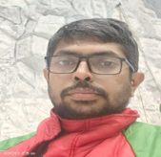
PAYMENTS EXPERT
Experience Attribute
Temenos (TPH) – 3+ years
Professional summary
Experience
A banking SME and expert in Treasury, Payments, Retail, Corporate banking, Securities, Swift message MT and MX. (MT101/Pain.001) (MT103, 202, 202cov) (Pacs.008 and Pacs.009) and other MT1 series, MT2 series, MT3 series and MT9 series.
Have hands on experience on TPH – Temenos T24 payment hub and T24 core banking (Treasury, Payments, Securities, Retail, Core modules).
Have hands on experience in ISO20022 implementation for HSBC across 47 markets/11 RTGS markets.
Have hands on experience in Payment transparency/Transaction monitoring functionality.
Have hands on experience in Digital PSD2 implementation for UK and EU markets.
Have implemented AIS Solution for UK corporate banking client which went live on first week of Oct 20. (Open banking UK).
Account Information services namely Account basic/Account detail API’s, Balance API’s, Transaction APIs, and consent APIs.
Knowledge on open banking UK (OBIE), FAPI compliance, EBA/European commission regulations on PSD2
implementation.
Manager- Payments Business Analyst | 2022 – current | Bank in Japan
Business analysis · Business requirements · Payments · Banking sector
Requirements gathering and scope/gap finalization for HK market. (Swift/RTGS CHATS)
TAABS – TPH configuration setup
HLSD/CR preparation and review and ensuring walkthrough to development/testing team.
Onsite travel pre-UAT training provided to remittance users and other workstream members.
Collaborating and liaising with Temenos on core TPH issues/bugs and L1 fixes for the same.
Senior Business Analyst | Capco – Bank in UK (Transformation project)
Environment: HUB Payment engine and UAT/SIT testing result evaluation
Business analyst and PMO role activities for ISO20022 program requirements.
Subject market expert for MT and MX mapping.
Payment transparency and Transaction monitoring requirements captured and provided for ISO20022 change with downstream systems and core banking.
Mapping review and deviations for CBPR+ implementation for 47 markets and RTGS MX implementation for 11 markets.
Walkthrough provided to testing team for UAT, SIT on ISO20022 changes.
Senior Business Analyst | Bank in Saudi (T24 Solution design/implementation)
Environment: Temenos T24
Worked on requirement specification with the bank Riyadh and developed functional specification solution for change requirements to T24 products across different functionalities involving Customer, Accounts, Payments, Corporate and Retail modules.
SRK
Payments Expert
Experience Attribute
Temenos Transact
TPH Temenos Payment Hub
Salesforce
Pega Platform
Banking compliance
Fraud & finance risks
Global payment
Remittance
Business analysis
ISO 20022
Open banking UK/ PSD2
Education
B.E (Electrical and Electronics)- Shirdi Sai Engineering College | Bengaluru
MBA FINANCE- CMRIT/VTU | Bengaluru

Slide 43
PAYMENTS BUSINESS ANALYST
Experience Attribute
IT Software Testing– 20+ Years of experience
Professional summary
Experience
Having 5+ years of Banking experience along with 2 years of Business Analyst-Payments Experince
Have experience and knowledge of working on Payments and Trade Finance
Experienced Agile implementer – hands on experience on implementing Agile techniques that cover various Agile ceremonies.
Effective communicator with excellent relationship building & interpersonal skills.
Strong analytical, problem solving & organizational abilities.
Managed Simultaneous Projects as a BA
Proficient in Microsoft Office (Word, Excel, Outlook, PowerPoint), Jira,Confluence
Quick to learn and understand new concepts
Have ability to work independently and with the team
Have positive attitude which helps in finding the solution or solving a problem
Language Known: English, Hindi, Telugu
Business Analyst –Payments(June 2022 – Till date)
Worked as Payments Business Analyst in Production Support- for India Implementation and Implementation –TPH for HK and currently payments in Wealth management program.
Prepared and Reviewed High-Level Solution Document and Detail Design Document
Preparation of End-to-End Flows, Change Requests and POC Documents
Worked firsthand in Implementation of Auto Mt191 Claims and Swift GPI
Defect Resolutions at ST,SIT,UAT phase
Provided Payments Fitment for another Japanese Bank
Onsite Go-Live Support for Hong Kong Implementation
Conducted Onsite Workshops in Hong Kong for Bank Users
Handled Internal TPH training for Other Workstreams
Co-ordinated between teams and banking COE leads to complete the tasks
Engaging the client for Requirement gathering and solution documentation
MB
Payments Business Analyst
Experience Attribute
Have a strong knowledge of financial domain
Have good experience as a Bank Manager & Payments Business Analyst
Have good understanding of Retail Banking, Wholesale Banking, Commercial Banking
Education
B.TECH in ECE from Vignan Institute of Technology

